Slide 1


CS 235: User Interface Design April 7 Class Meeting
Department of Computer Science San Jose State University Spring 2015 Instructor: Ron Mak
www.cs.sjsu.edu/~mak

Slide 2
Unofficial Field Trip
Computer History Museum in Mt. View
http://www.computerhistory.org/
Saturday, May 9, 11:30 – closing time
Special free admission.
Do a self-guided tour of the new Revolution exhibit.
See a life-size working model of Charles Babbage’s Difference Engine in operation, a hand-cranked mechanical computer designed in the early 1800s.
Experience a fully restored IBM 1401 mainframe computer from the early 1960s in operation.
General info: http://en.wikipedia.org/wiki/IBM_1401
My summer seminar: http://www.cs.sjsu.edu/~mak/1401/
Restoration: http://ed-thelen.org/1401Project/1401RestorationPage.html

Slide 3
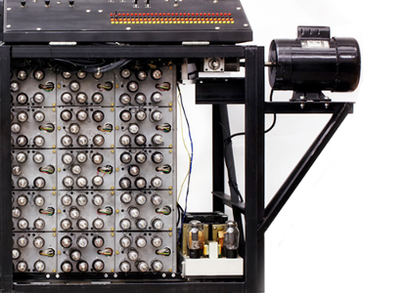
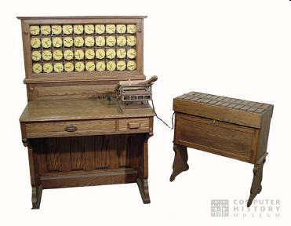
Unofficial Field Trip
The new Revolution exhibit is now open!
Walk through a timeline of the First 2000 Years of Computing History.
Historic computer systems, data processing equipment, and other artifacts.
Small theater presentations.
Hollerith
Census
Machine
Atanasoff-Berry
Computer

Slide 4
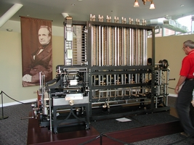
Unofficial Field Trip
Babbage Difference Engine, fully operational.
Hand-cranked mechanical computer.
Computed polynomial functions.
Designed by Charles Babbage in the early to mid 1800s.
Arguably the world’s first computer scientist, lived 1791-1871.
He wasn’t able to build it because he lost his funding.
Live demo at 1:00
His plans survived and this working model was built.
Includes a working printer!
http://www.computerhistory.org/babbage/

Slide 5
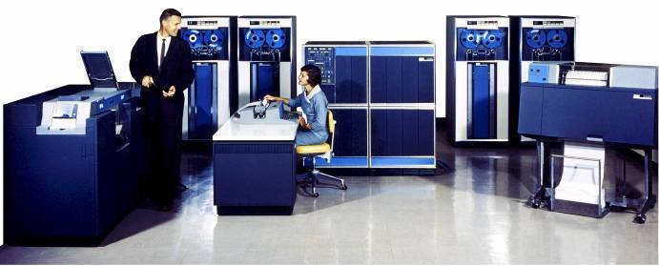
Unofficial Field Trip
IBM 1401 computer, fully restored and operational
A small transistor-based mainframe computer.
Extremely popular with small businesses in the late 1950s through the mid 1960s
Maximum of 16K bytes of memory.
800 card/minute card reader (wire brushes).
600 line/minute line printer (impact).
6 magnetic tape drives, no disk drives.

Slide 6
Some Sources of Data for Visualization
Google “datasets for data visualization”
http://archive.ics.uci.edu/ml/
http://www.kdnuggets.com/datasets/index.html
https://www.kaggle.com/competitions
http://www.visualizing.org/data/browse
http://datavisualization.ch/datasets/
http://www.idvbook.com/teaching-aid/data-sets/
http://blog.visual.ly/data-sources/
https://www.google.com/publicdata/directory

Slide 7
Forms
Solicit input from users:
sign in
registration
checkout
calculation
search
multi-step
long

Slide 8
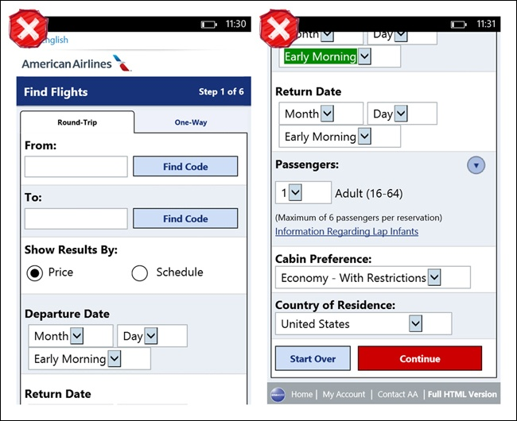
Form Abandonment
A serious problem.
A user gives up before completing a form.
Information is not submitted.
Poor form design:
American Airlines
Flight Booking
on Windows Phone
Mobile Design Pattern Gallery, 2nd ed.
by Theresa Neil
O’Reilly, 2014

Slide 9
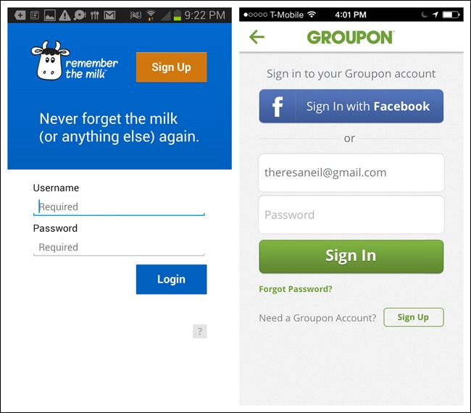
Sign In
Ask for only the minimum number of inputs:
username
password
password help
command button
option to register
Remember the Milk for Android
Groupon for iOS
Mobile Design Pattern Gallery, 2nd ed.
by Theresa Neil
O’Reilly, 2014

Slide 10
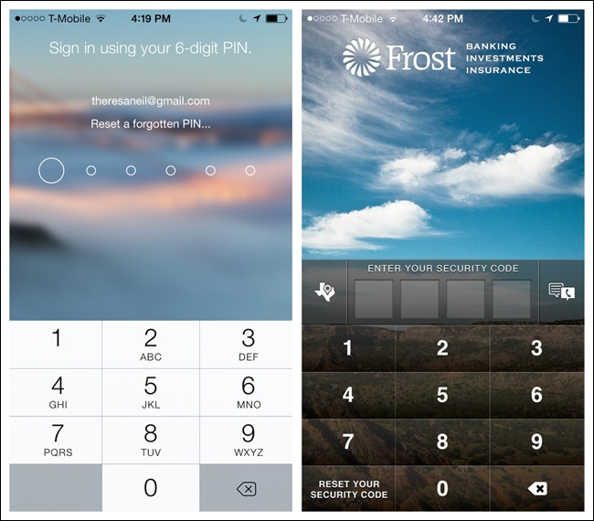
Sign In, cont’d
Option: Sign in with a PIN only
Personal Capital
for iOS
Frost
for iOS
Mobile Design Pattern Gallery, 2nd ed.
by Theresa Neil
O’Reilly, 2014

Slide 11
Sign In, cont’d
Signing in should not necessarily be the first step.
Consider asking the user to sign in only when authentication is necessary.

Slide 12
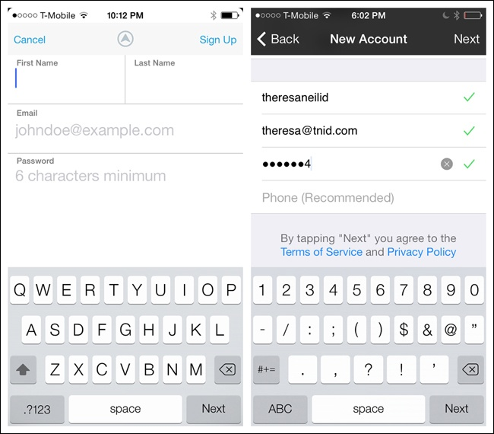
Registration
Ask for the minimum number of inputs.
Each additional field lowers form conversion.
Test to validate fields as they’re being entered.
Rove and Kirk for iOS
Mobile Design Pattern Gallery, 2nd ed.
by Theresa Neil
O’Reilly, 2014

Slide 13
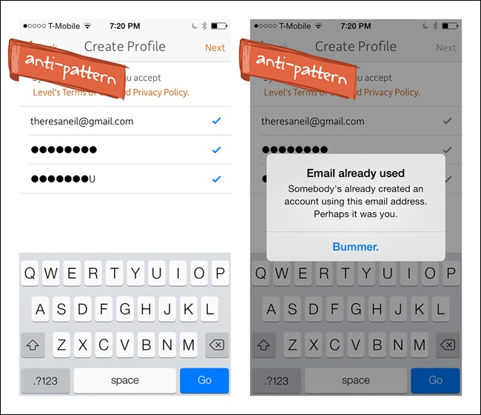
Registration, cont’d
Inform users about problems as soon as possible.
Level
for iOS
Mobile Design Pattern Gallery, 2nd ed.
by Theresa Neil
O’Reilly, 2014

Slide 14
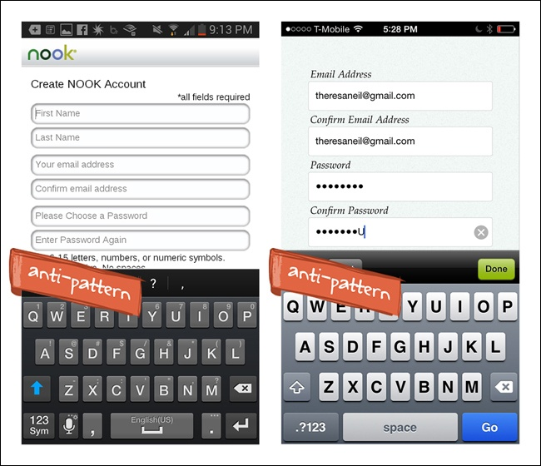
Registration, cont’d
Don’t have redundant fields.
NOOK
for Android
LearnVest
for iOS
Mobile Design Pattern Gallery, 2nd ed.
by Theresa Neil
O’Reilly, 2014

Slide 15
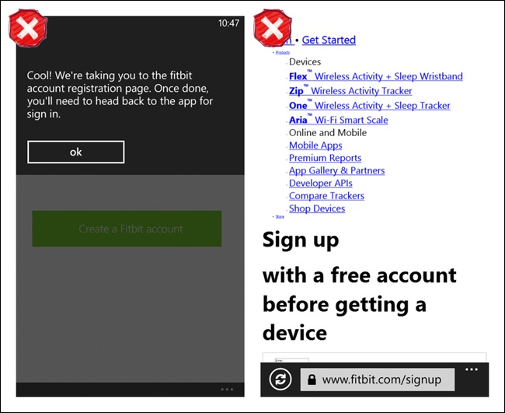
Registration, cont’d
During the registration process:
Keep the user in the application if possible.
Linking to an external web page can be problematical.
Fitbit for Windows Phone
Mobile Design Pattern Gallery, 2nd ed.
by Theresa Neil
O’Reilly, 2014

Slide 16
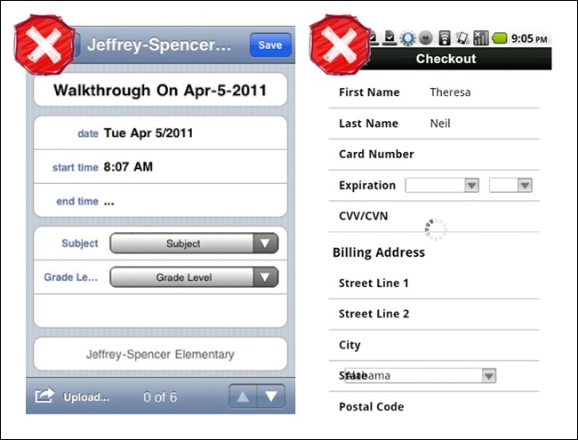
Registration, cont’d
Horizontal labels can get truncated or overlapped.
Mobile Design Pattern Gallery, 2nd ed.
by Theresa Neil
O’Reilly, 2014

Slide 17
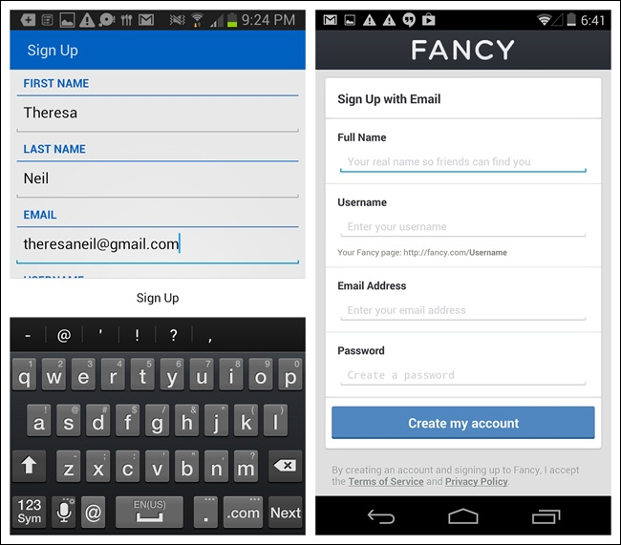
Registration, cont’d
Use vertically aligned labels instead.
Remember the Milk
for Android
Fancy
for Android
Mobile Design Pattern Gallery, 2nd ed.
by Theresa Neil
O’Reilly, 2014

Slide 18
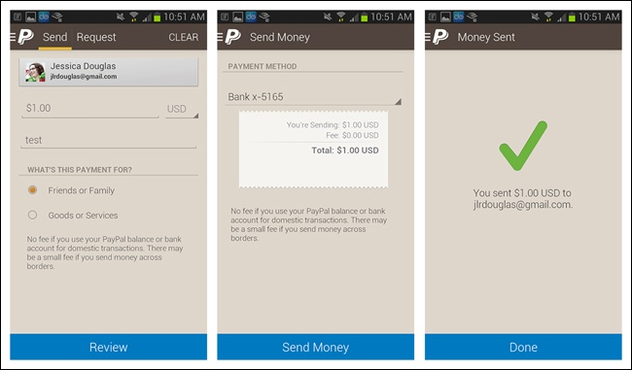
Multi-Step
Show progress during multi-step forms.
PayPal for Android
Mobile Design Pattern Gallery, 2nd ed.
by Theresa Neil
O’Reilly, 2014

Slide 19
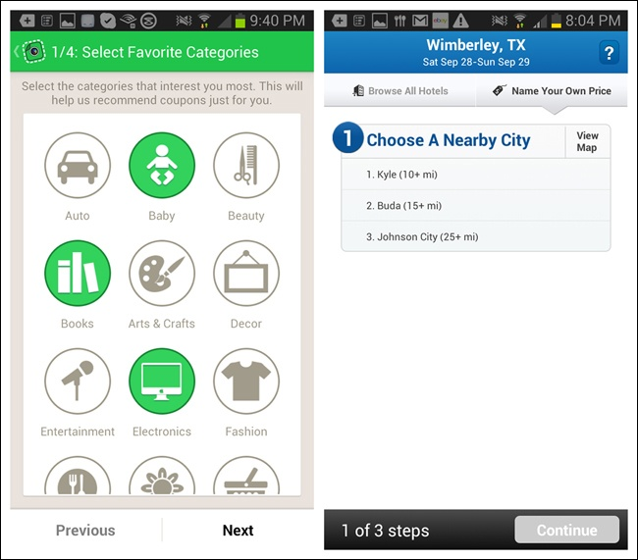
Multi-Step, cont’d
Indicate the current step number and the total number of steps.
SnipSnap for Android
Priceline for Android
Mobile Design Pattern Gallery, 2nd ed.
by Theresa Neil
O’Reilly, 2014

Slide 20
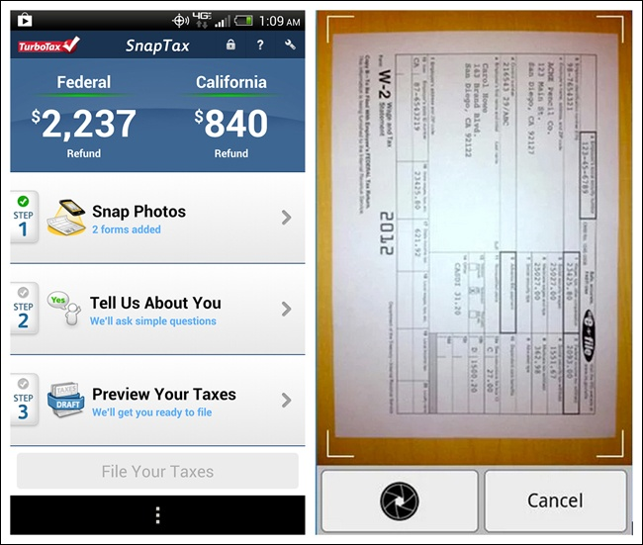
Multi-Step, cont’d
Use drill-down to see more details.
TurboTax
for Android
Mobile Design Pattern Gallery, 2nd ed.
by Theresa Neil
O’Reilly, 2014

Slide 21
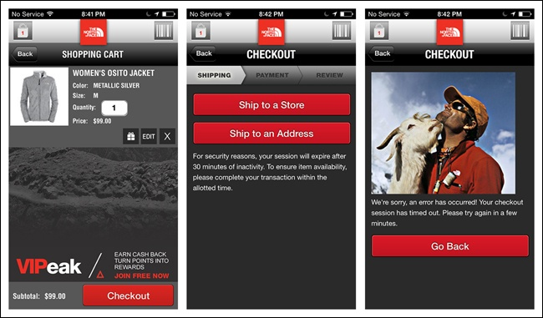
Checkout
Don’t let poor UX design deter users from doing a sales checkout on their smartphones.
North Face for iOS
Mobile Design Pattern Gallery, 2nd ed.
by Theresa Neil
O’Reilly, 2014

Slide 22
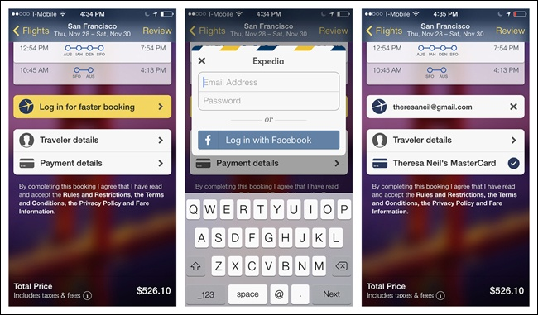
Checkout, cont’d
Prepopulate the checkout form for a signed-in user.
Expedia for iOS
Mobile Design Pattern Gallery, 2nd ed.
by Theresa Neil
O’Reilly, 2014

Slide 23
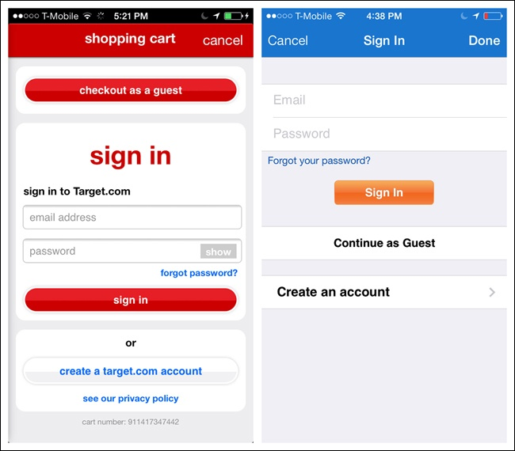
Checkout, cont’d
Offer sign in and registration options, along with guest checkout.
Target
for iOS
Walmart
for iOS
Mobile Design Pattern Gallery, 2nd ed.
by Theresa Neil
O’Reilly, 2014

Slide 24
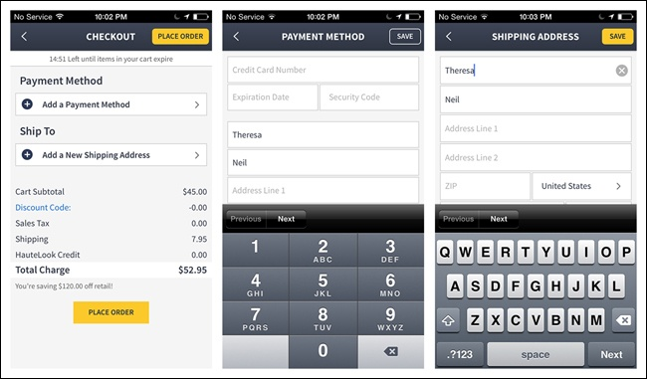
Checkout, cont’d
Streamline the checkout process.
Consolidate multiple screens into one screen.
Use drill-down to screens for additional input.
Haute
for iOS
Mobile Design Pattern Gallery, 2nd ed.
by Theresa Neil
O’Reilly, 2014

Slide 25
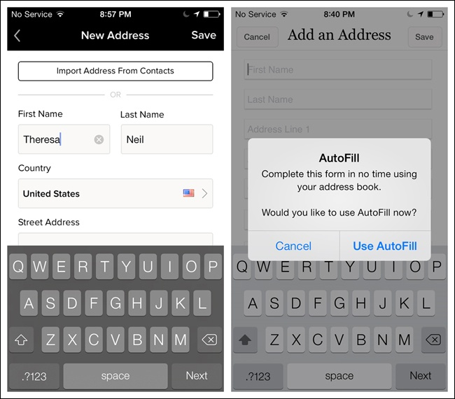
Checkout, cont’d
Provide time-saving shortcuts
Gilt
for iOS
RuLaLa
for iOS
Mobile Design Pattern Gallery, 2nd ed.
by Theresa Neil
O’Reilly, 2014

Slide 26
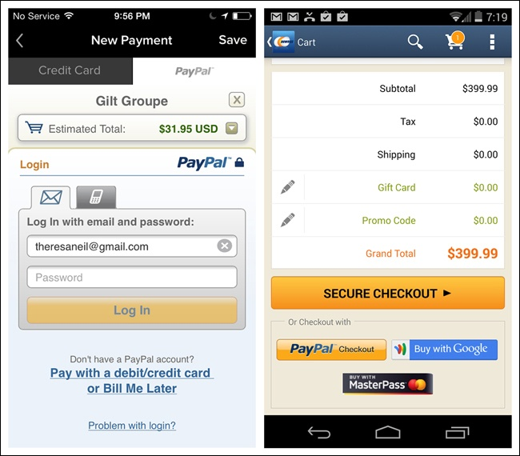
Checkout, cont’d
Offer express checkout options.
Gilt
for iOS
Newegg
for Android
Mobile Design Pattern Gallery, 2nd ed.
by Theresa Neil
O’Reilly, 2014

Slide 27
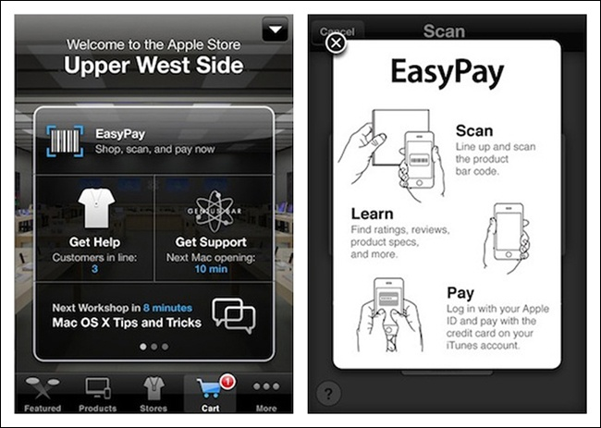
Checkout, cont’d
Offer in-store checkout using a smartphone.
Apple Store
Mobile Design Pattern Gallery, 2nd ed.
by Theresa Neil
O’Reilly, 2014

Slide 28
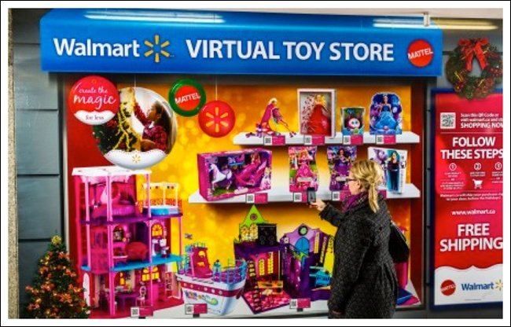
Checkout, cont’d
Mattel’s Virtual Toy Store in Walmart Canada
Mobile Design Pattern Gallery, 2nd ed.
by Theresa Neil
O’Reilly, 2014

Slide 29
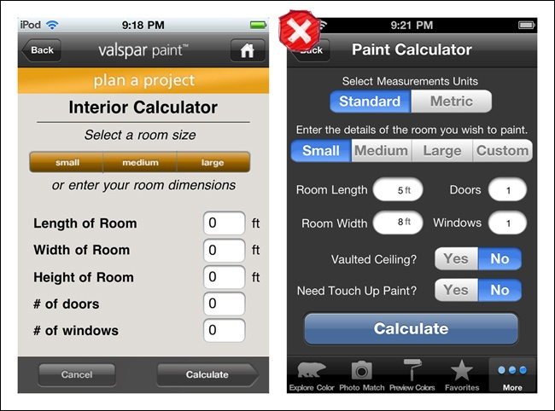
Calculator Forms
Use well-aligned fields.
Valspar Paint Calculator
Behr Paint Calculator
Mobile Design Pattern Gallery, 2nd ed.
by Theresa Neil
O’Reilly, 2014

Slide 30
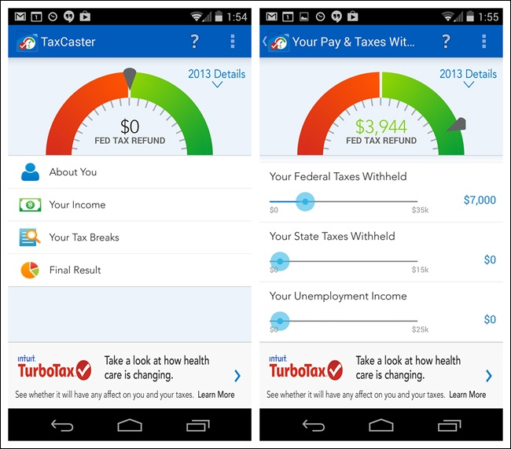
Calculator Forms, cont’d
Use interactive data visualizations if appropriate.
TaxCaster
for Android
Mobile Design Pattern Gallery, 2nd ed.
by Theresa Neil
O’Reilly, 2014

Slide 31
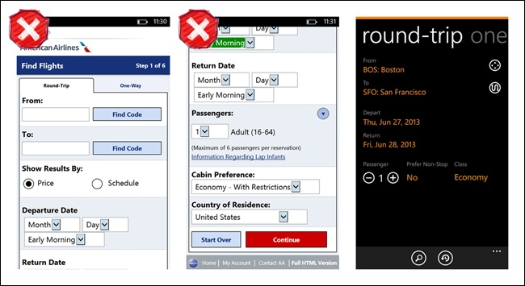
Search Forms
Ask for the minimum number of inputs.
American Airlines for Windows Phone
Kayak for Windows Phone
Mobile Design Pattern Gallery, 2nd ed.
by Theresa Neil
O’Reilly, 2014

Slide 32
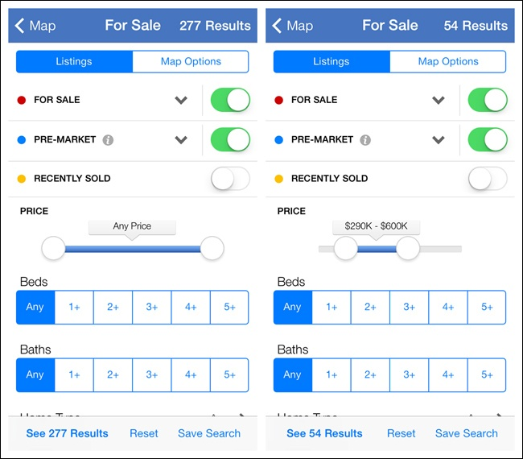
Search Forms, cont’d
Display results as the user enters search criteria.
Zillow
for iOS
Mobile Design Pattern Gallery, 2nd ed.
by Theresa Neil
O’Reilly, 2014

Slide 33
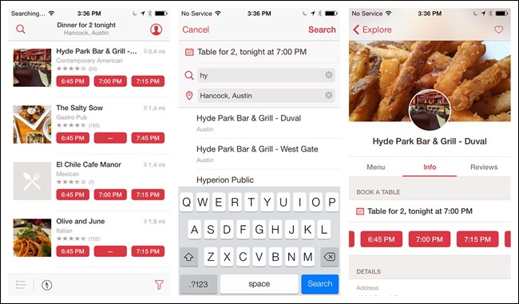
Search Forms, cont’d
Implicit search: Make automatic suggestions.
OpenTable for iOS
Mobile Design Pattern Gallery, 2nd ed.
by Theresa Neil
O’Reilly, 2014

Slide 34
Long Forms
Some forms can’t fit on a single screen.
A long scrolling page is better than a form broken up over multiple pages.
Where do you put the command button?

Slide 35
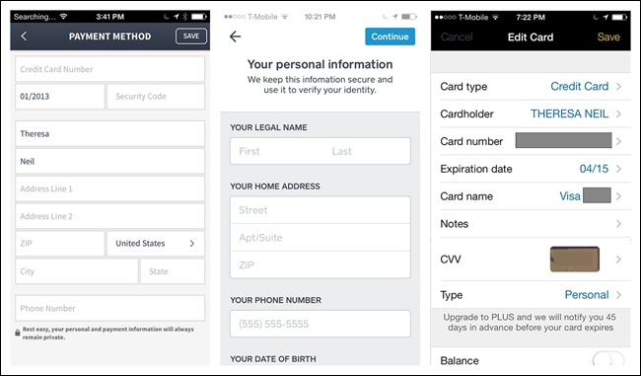
Long Form Guidelines: iOS
Command button at the top right
Escape button (Back or Cancel) at the top left
HauteLook
Square
Lemon Wallet
Mobile Design Pattern Gallery, 2nd ed.
by Theresa Neil
O’Reilly, 2014

Slide 36
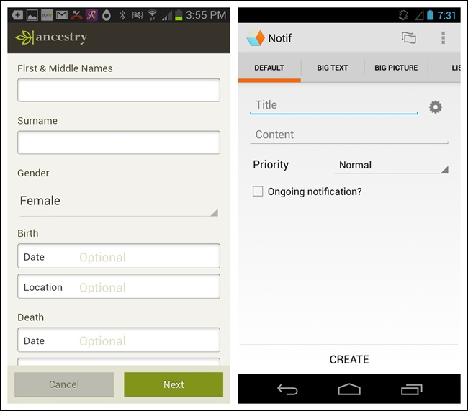
Long Form Guidelines: Android
Command button in the footer
Ancestry
Notif
Mobile Design Pattern Gallery, 2nd ed.
by Theresa Neil
O’Reilly, 2014

Slide 37
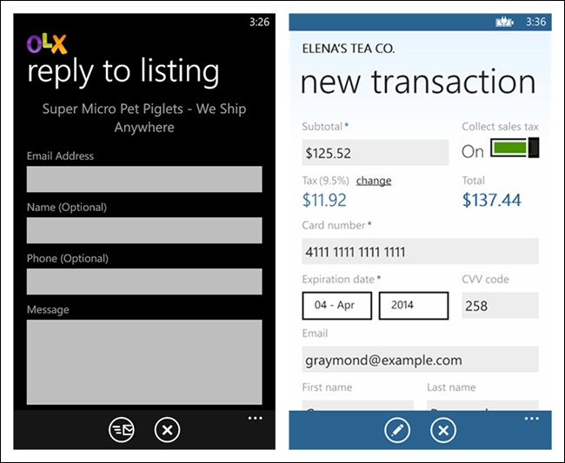
Long Form Guidelines: Windows Phone
Command button in the App Bar at the bottom
OLX
Innerfence
Mobile Design Pattern Gallery, 2nd ed.
by Theresa Neil
O’Reilly, 2014

Slide 38
Anti-Patterns
What not to do.
Pitfalls to avoid.
Commonly reinvented bad solutions to problems.
Poor attempt to convert a web app to mobile.
Examples:
Nonstandard menu location.
Hard-to-read text.
Too many colors.
Too hard to navigate.

Slide 39
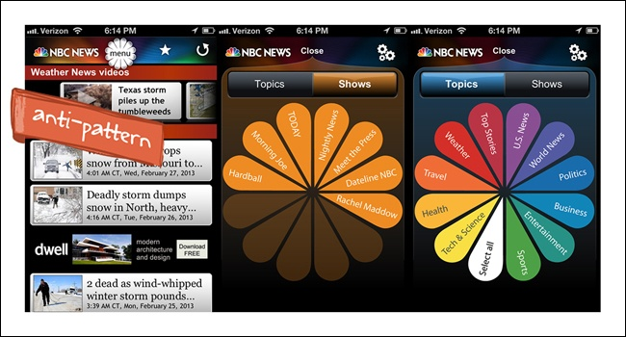
Anti-Pattern: Novel Notions
Bad attempt to incorporate the company logo
NBC News for iOS
Mobile Design Pattern Gallery, 2nd ed.
by Theresa Neil
O’Reilly, 2014

Slide 40
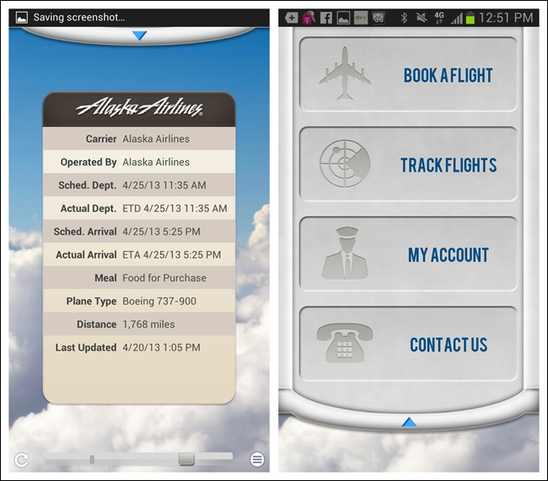
Anti-Pattern: Skeuomorphic Cuteness
Bad attempt to simulate an airplane window shade
Alaska Airlines
for Android
Mobile Design Pattern Gallery, 2nd ed.
by Theresa Neil
O’Reilly, 2014

Slide 41
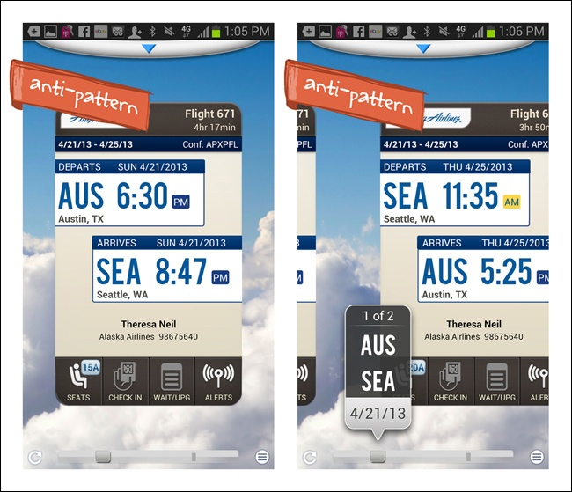
Anti-Pattern: Nonstandard Navigation
Unusual card navigation using a bottom scrollbar
Alaska Airlines
for Android
Mobile Design Pattern Gallery, 2nd ed.
by Theresa Neil
O’Reilly, 2014

Slide 42
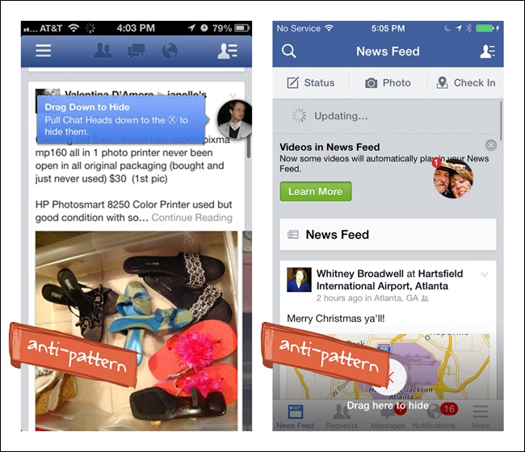
Anti-Pattern: Needless Complexity
How to remove nonintuitive “Chat Heads”
Facebook
for iOS
Mobile Design Pattern Gallery, 2nd ed.
by Theresa Neil
O’Reilly, 2014

Slide 43
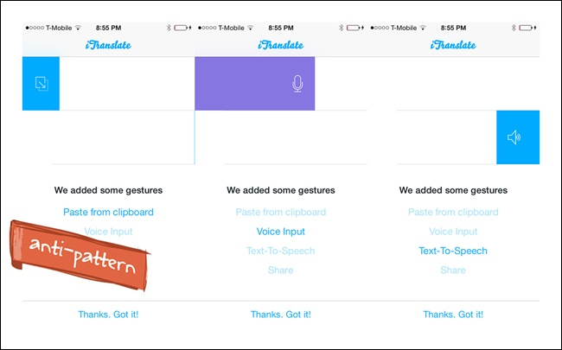
Anti-Pattern: Needless Complexity, cont’d
Nonintuitive gestures
iTranslate
for iOS
Mobile Design Pattern Gallery, 2nd ed.
by Theresa Neil
O’Reilly, 2014

Slide 44
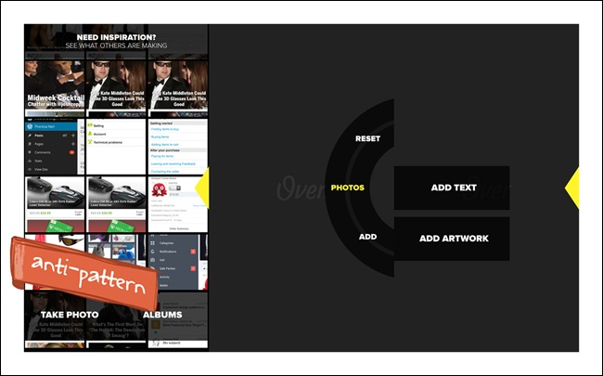
Anti-Pattern: Bad Navigation Controls
Over for iOS
Mobile Design Pattern Gallery, 2nd ed.
by Theresa Neil
O’Reilly, 2014

Slide 45
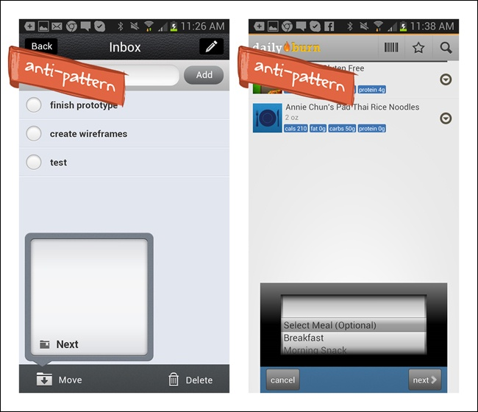
Anti-Pattern: Bad Navigation Controls, cont’d
iOS-style controls in Android apps
Conqu
for Android
DailyBurn
for Android
Mobile Design Pattern Gallery, 2nd ed.
by Theresa Neil
O’Reilly, 2014

Slide 46
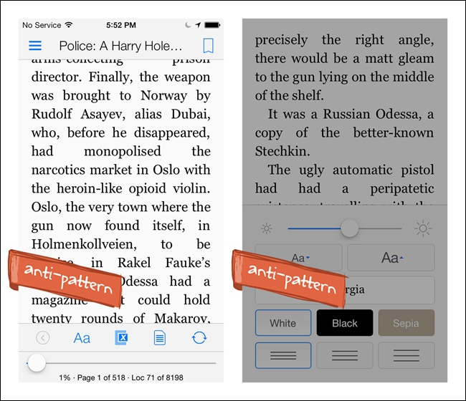
Anti-Pattern: Hidden Controls
Brightness control under the font properties icon.
Kindle
for iOS
Mobile Design Pattern Gallery, 2nd ed.
by Theresa Neil
O’Reilly, 2014

Slide 47
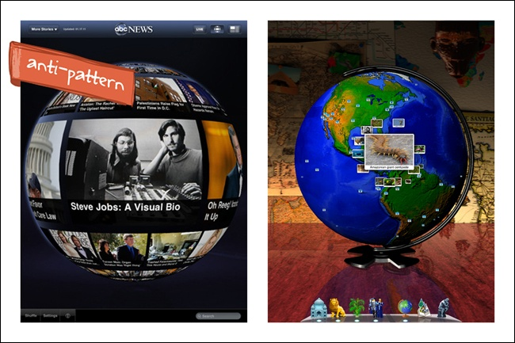
Anti-Pattern: Mental Model Mismatch
ABC News misuses a globe for navigation.
Geo Walk’s globe provides geographic context.
ABC News
for iPad
Geo Walk
for iOS
Mobile Design Pattern Gallery, 2nd ed.
by Theresa Neil
O’Reilly, 2014

Slide 48
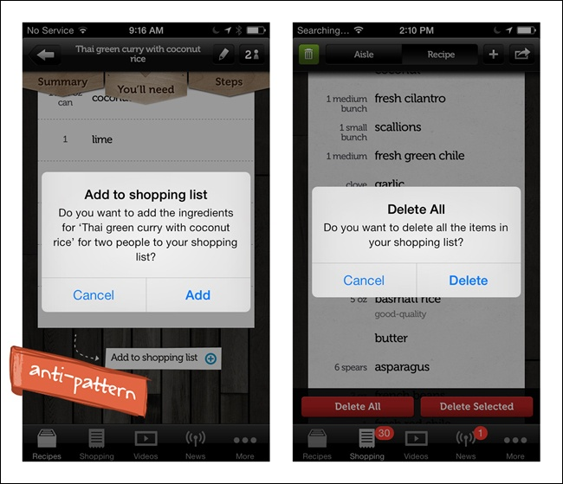
Anti-Pattern: Idiot Boxes
Useless or disruptive prompting dialog boxes
Jamie Oliver’s
Recipes for iOS
Mobile Design Pattern Gallery, 2nd ed.
by Theresa Neil
O’Reilly, 2014

Slide 49
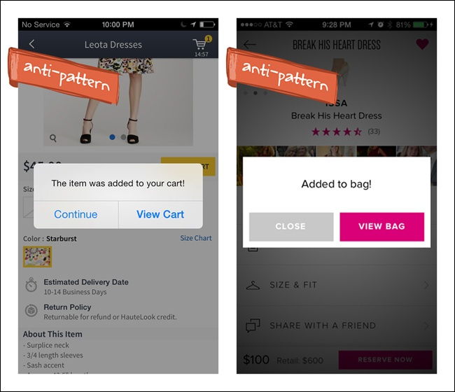
Anti-Pattern: Idiot Boxes, cont’d
Haute
for iOS
Rent the
Runway
for iOS
Mobile Design Pattern Gallery, 2nd ed.
by Theresa Neil
O’Reilly, 2014

Slide 50
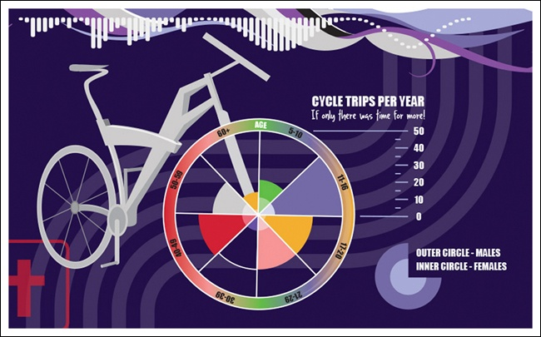
Anti-Pattern: Chart Junk
WTFViz
Mobile Design Pattern Gallery, 2nd ed.
by Theresa Neil
O’Reilly, 2014

Slide 51
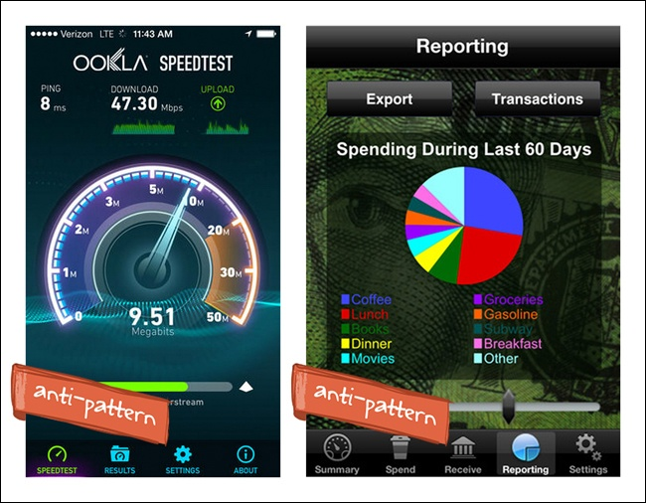
Anti-Pattern: Chart Junk, cont’d
OOKLA
Speedtest
for Android
Cashish
for iOS
Mobile Design Pattern Gallery, 2nd ed.
by Theresa Neil
O’Reilly, 2014

Slide 52
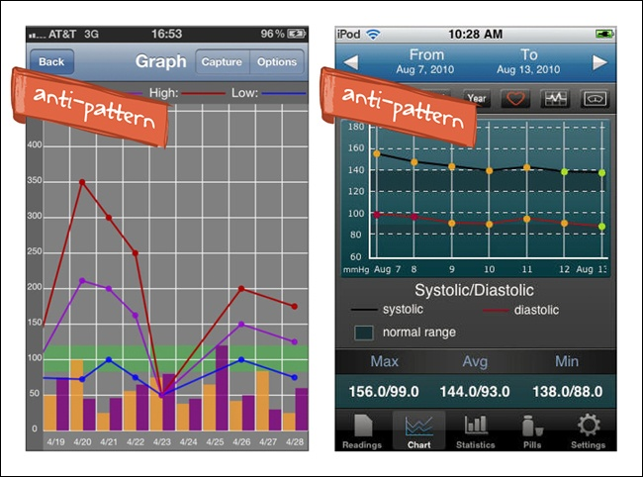
Anti-Pattern: Chart Junk, cont’d
Glucose
Buddy
for iOS
Heart
Pal
for iOS
Mobile Design Pattern Gallery, 2nd ed.
by Theresa Neil
O’Reilly, 2014

Slide 53
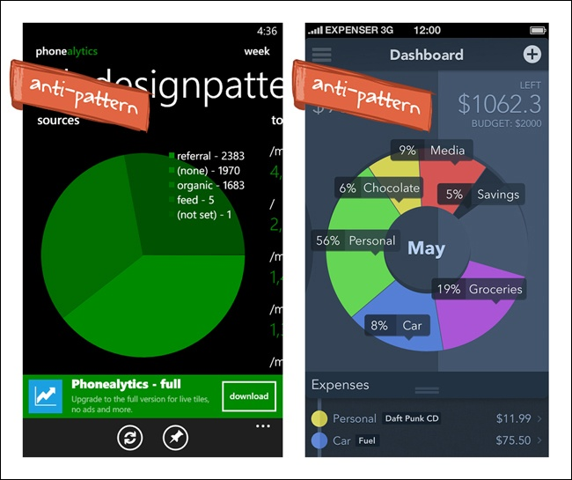
Anti-Pattern: Chart Junk, cont’d
Pie charts are a poor fit for smartphone screens.
Hard to show both the chart and its legend.
Phonealytics for
Windows Phone
Chart design
concept for iOS
Mobile Design Pattern Gallery, 2nd ed.
by Theresa Neil
O’Reilly, 2014

Slide 54
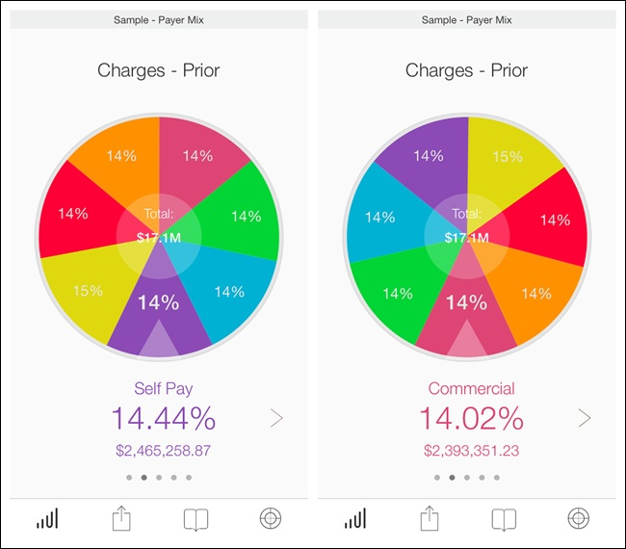
Anti-Pattern: Chart Junk, cont’d
Pie charts can be done well.
Roambi
for iOS
Mobile Design Pattern Gallery, 2nd ed.
by Theresa Neil
O’Reilly, 2014

Slide 55
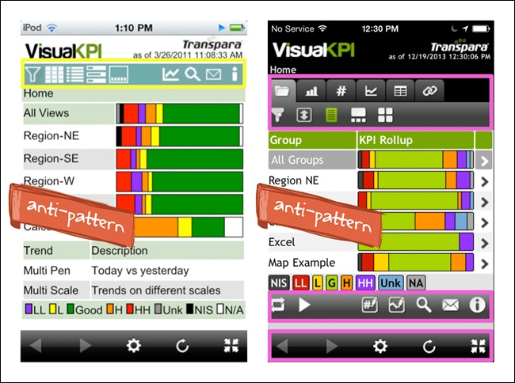
Anti-Pattern: Too Many Buttons
Visual PKI
for iOS
Mobile Design Pattern Gallery, 2nd ed.
by Theresa Neil
O’Reilly, 2014

Slide 56
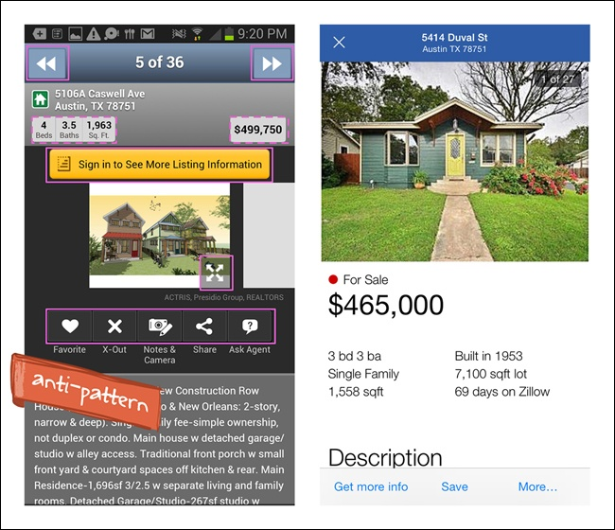
Anti-Pattern: Too Many Buttons, cont’d
Redfin
for Android
Zillow
for iOS
Mobile Design Pattern Gallery, 2nd ed.
by Theresa Neil
O’Reilly, 2014

Slide 57

Anti-Pattern: Poor Platform Porting
Bad direct design port from iOS to Android.
Behr Paint
for Android
Mobile Design Pattern Gallery, 2nd ed.
by Theresa Neil
O’Reilly, 2014

